Slide 1
COMP424 GROUP F Progress Report
Group Members:
Samuel Habte.
Chandrika Darbha.
Alfaisal Qasem M Alqahtani.

Slide 2
Project Idea
Developing a Commercial Apartment Rental Building Customer Relationship Management full stack application.
Motivation:
We observed that commercial apartment rental properties do not have an app for internal business process communication with clients.

Slide 3
Main functionalities
Owners:
Post events, announcements for all clients,
Notify the status of specific service request by clients,
Inform gym signup and renewal dates,
Disclose rent and other service payment amounts with deadlines.
Clients:
Request different types of services such as maintenance, gym signup, postal delivery to the building management office.
Receive different announcements, notifications and events as well as community news.

Slide 4
What we have done so far
The team discussed the project idea and accepted to work on the project.
Build UI mockups.
Build static pages from mockups.
The application is not used for customers who look for an apartment to rent.

Slide 5
Tools used
HTML, CSS and JS – for UI.
FluidUI wireframes – for Mockups.
Github – version control.
Next step tools used:
Node and express.
Mongodb.

Slide 6
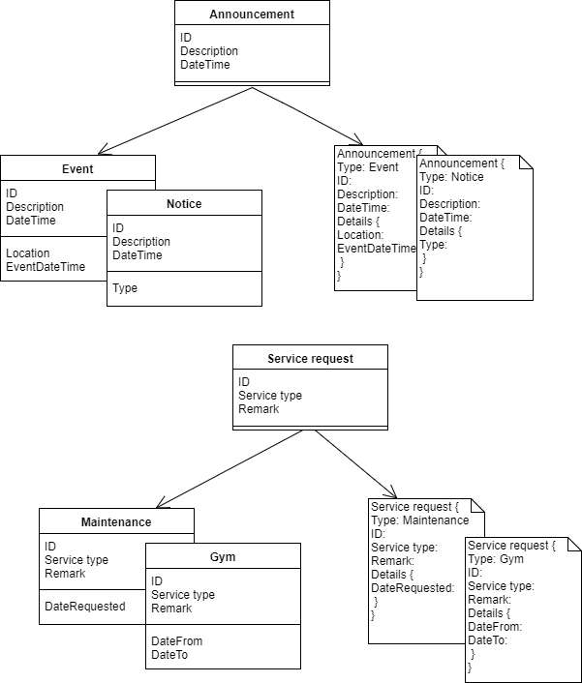

Slide 7
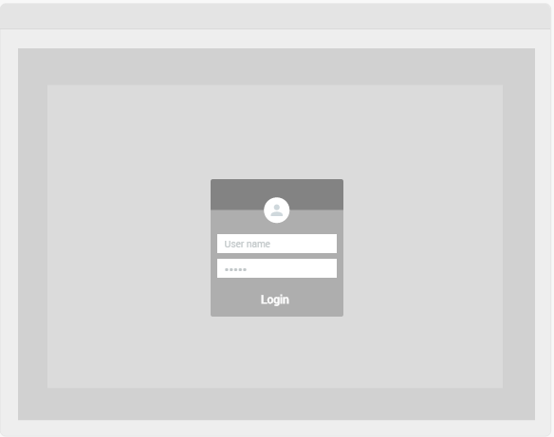

Slide 8
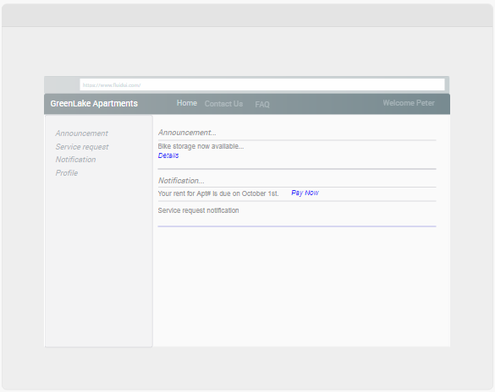

Slide 9
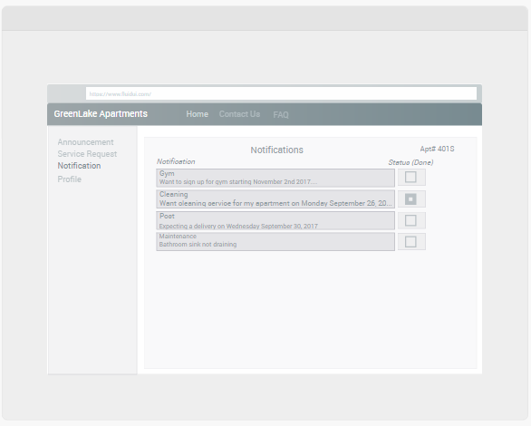

Slide 10
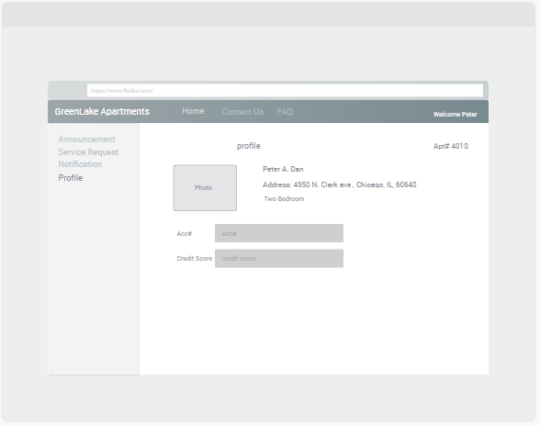

Slide 11
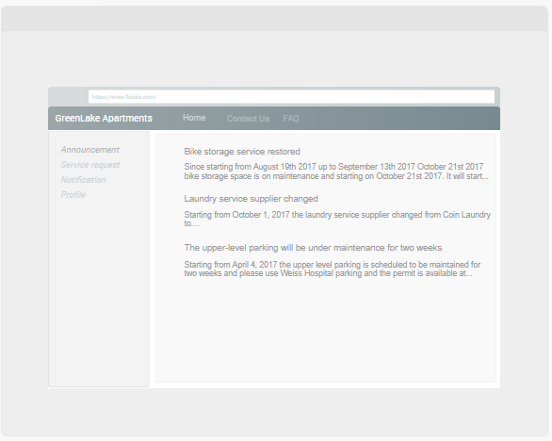

Slide 12
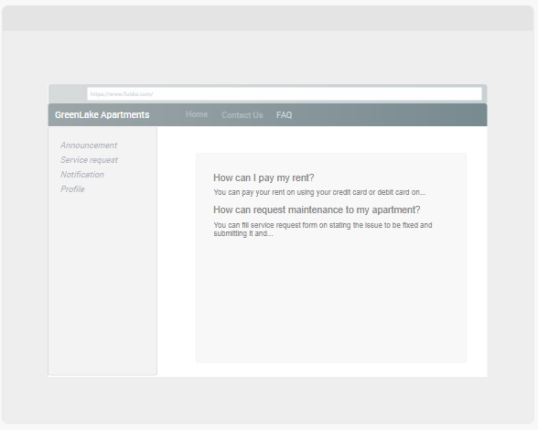

Slide 13
